Slide 1
CS 4032 – Web Programming
Dr. Hassan Sartaj

Slide 2
CSS - Cascading Style Sheets

Slide 3
History of CSS
1994: Cascading HTML style sheets—a proposal
Hakon W Lie proposed CSS
Working with Tim-Berners Lee at CERN
1996: CSS1 standard, recommended by W3C
Defines basic styling elements like font, color, alignment, margin, padding, etc.
1998: CSS2 standard, recommended by W3C
Adds positioning schemes, z-index, new font properties, etc.
2011: CSS3 standards, structured in modules
Add more powerful selectors, responsive web design, etc.

Slide 4
What is CSS ?
CSS defines how to display an html document
fonts, colors, layouts, etc.
Usually CSS styles are specified in an external file
Separates visual presentation (CSS) from document structure (HTML)
Enables developers to change the layout and look of all documents in a website by just editing a single file

Slide 5
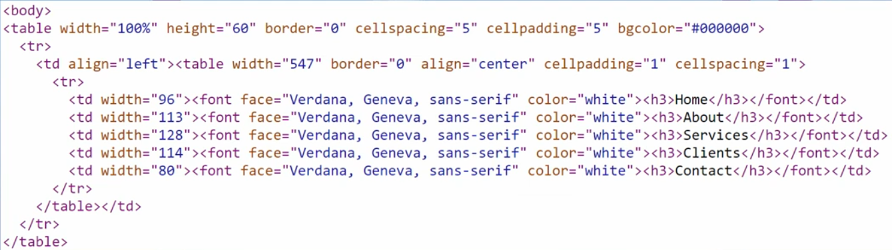
Need for CSS
Not much flexibility in positioning of content
Inefficient and repetitive
Cannot stack multiple objects (e.g., images) on top of one another

Slide 6
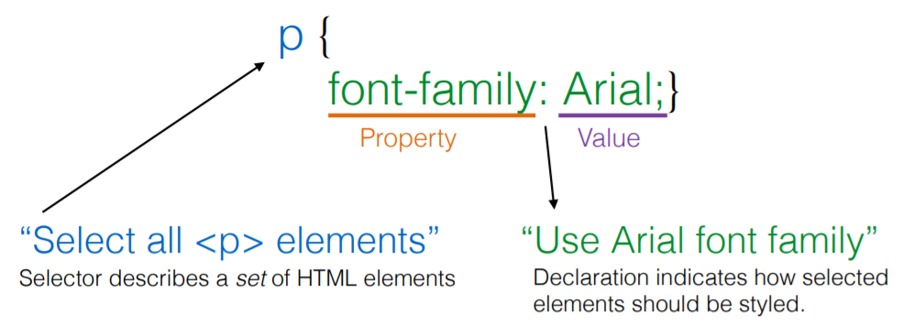
CSS Syntax
selector { property: value; property: value; … }

Slide 7
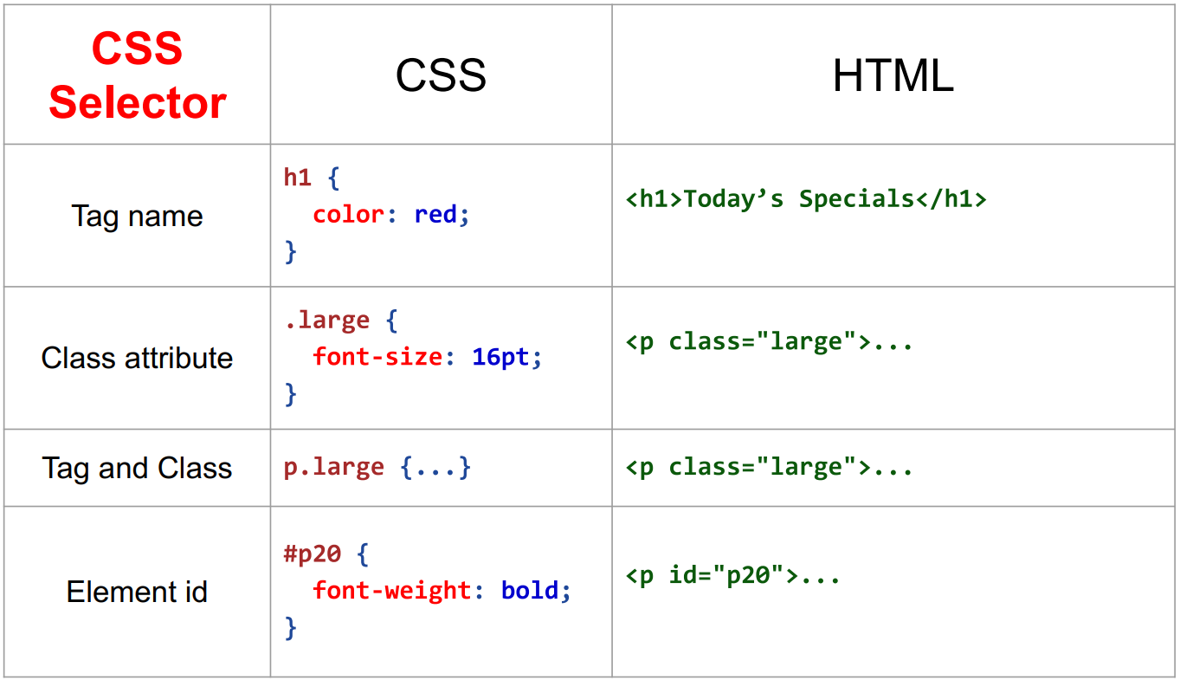
CSS Selectors

Slide 8
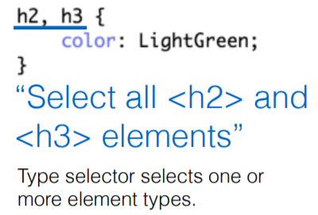
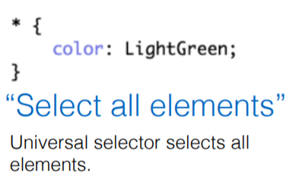
CSS Type Selectors

Slide 9
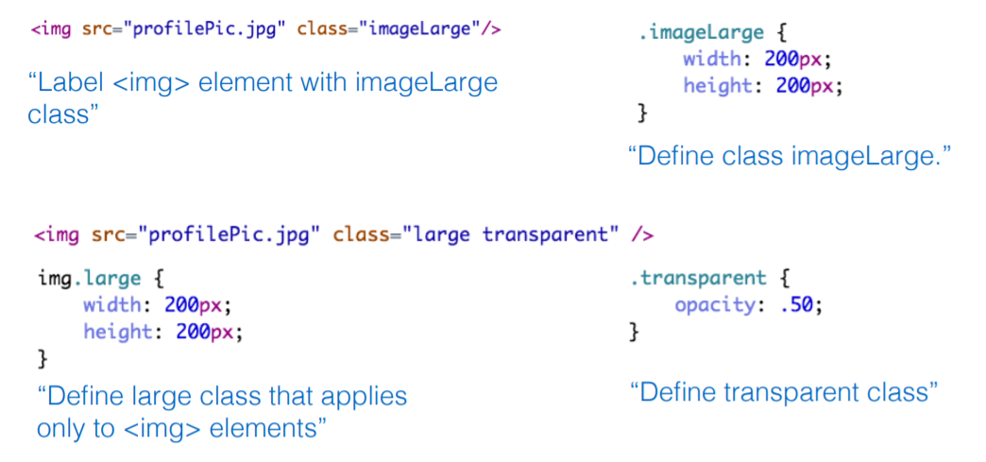
CSS Class Selectors

Slide 10
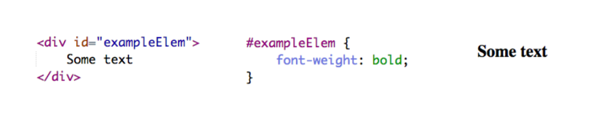
CSS Id Selectors

Slide 11
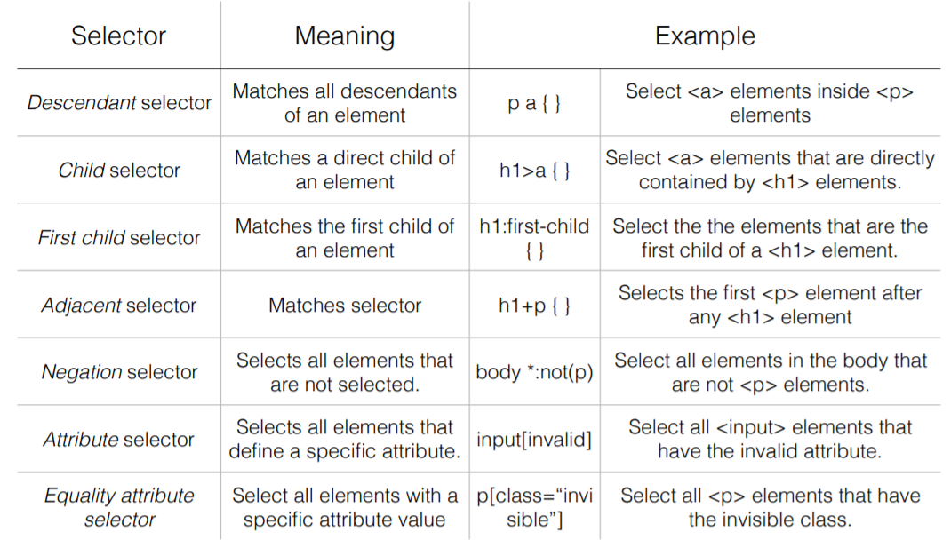
Additional Selector Types

Slide 12
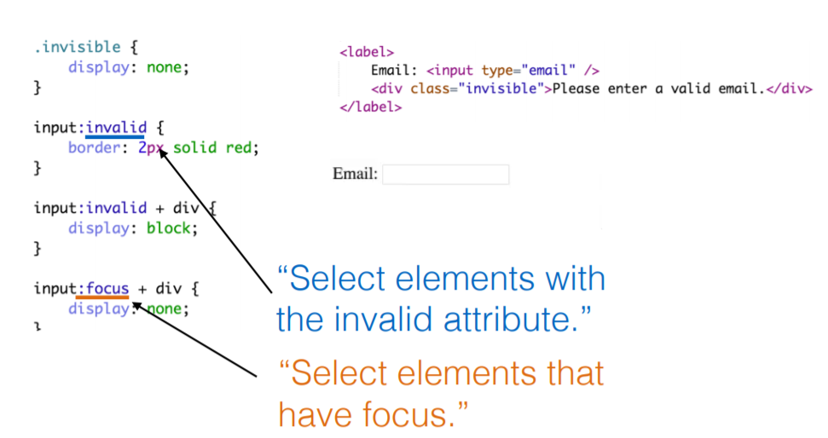
Pseudo Selectors/Classes
Syntax:
selector:pseudo-class {property: value; …}
selector.class:pseudo-class {property: value; …}

Slide 13
Examples of pseudo classes
:active - elements activated by user. For mouse clicks, occurs between mouse down and mouse up.
:checked - radio, checkbox, option elements that are checked by user
:disabled - elements that can’t receive focus
:empty - elements with no children
:focus - element that currently has the focus
:hover - elements that are currently hovered over by mouse
:invalid - elements that are currently invalid
:link - link element that has not yet been visited
:visited - link element that has been visited
:lang: adds a style to an element with a specific lang attribute

Slide 14
Pseudo-elements
syntax:
selector:pseudo-element {property: value; …}
selector.class:pseudo-element {property: value; …}
list of pseudo-elements:
:first-letter – adds style to the first character of a text
p:first-letter { font-size: xx-large; }
:first-line – adds style to the first line of a text
p:first-line { color: red }
:before – adds content before an element
h1:before { content: url(smiley.jpg)}
:after – adds content after an element
h1:after { content: url(smiley.jpg)}

Slide 15
A simple CSS example
body {background-color: #aabbcc}
h1 {font-style: italic; font-size: 36pt}
h2 {color: blue}
p {margin-left: 50px}
It specifies that:
the <body> tag should have a background color of #aabbcc
the <h1> heading tag should use an italic font of size 36pt
the <h2> heading tag should use a blue color for displaying text
a paragraph <p> tag should start at an offset of 50 pixels on the left

Slide 16
Adding style sheets to a document
External style sheet:
<head>
<link rel=“stylesheet” type=“text/css” href=“style.css”>
</head>
Internal style sheet:
<head>
<style type=“text/css”>
p { margin-left: 10px }
</style>
</head>
Inline style sheet:
<p style=“color: red; margin-left: 10px}

Slide 17
Multiple style sheets
If multiple style sheets are defined, their priority is:
Inline style
External style sheet
Internal style sheet
Browser default

Slide 18
Background properties
Property | Description
background | Sets all the background properties in one declaration
background-attachment | Sets whether a background image is fixed or scrolls with the rest of the page
background-color | Sets the background color of an element
background-image | Sets the background image for an element
background-position | Sets the starting position of a background image
background-repeat | Sets how a background image will be repeated

Slide 19
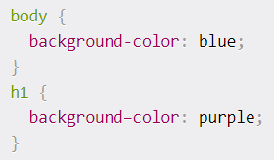

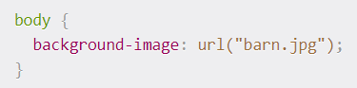
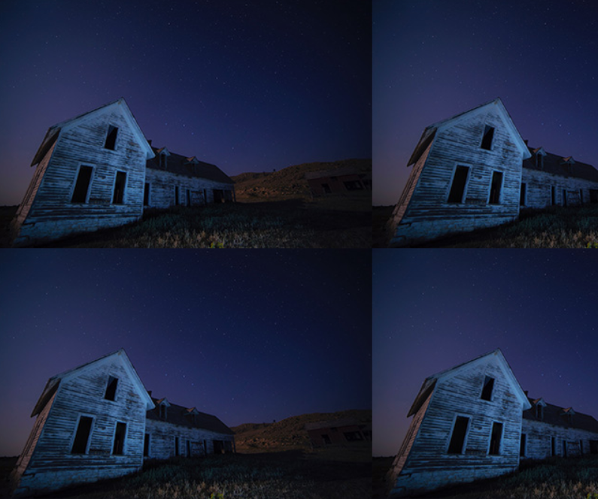
Background CSS examples

Slide 20
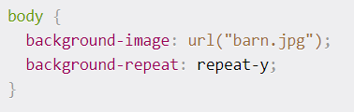
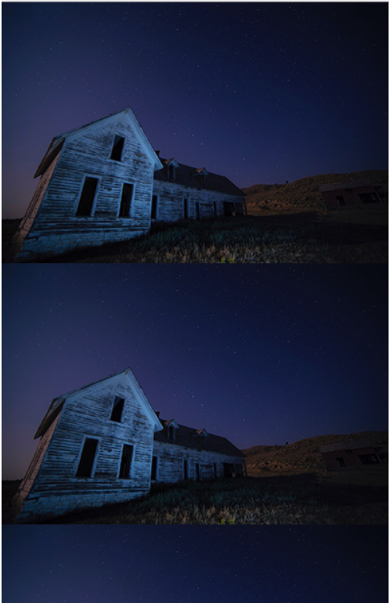
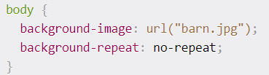

Background CSS examples

Slide 21

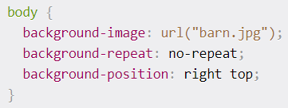

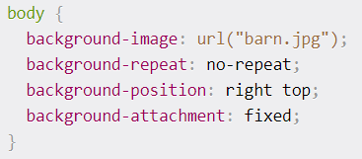
Background CSS examples

Slide 22
Text properties
Property | Description
color | Sets the color of text
direction | Specifies the text direction/writing direction
letter-spacing | Increases or decreases the space between characters in a text
line-height | Sets the line height
text-align | Specifies the horizontal alignment of text
text-decoration | Specifies the decoration added to text
text-indent | Specifies the indentation of the first line in a text-block
text-shadow | Specifies the shadow effect added to text
text-transform | Controls the capitalization of text
vertical-align | Sets the vertical alignment of an element
white-space | Specifies how white-space inside an element is handled
word-spacing | Increases or decreases the space between words in a text

Slide 23
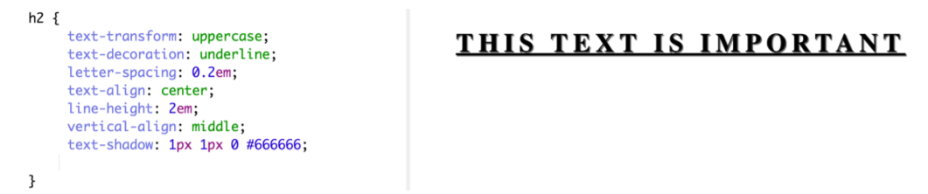
Text CSS example

Slide 24
Display and visibility
Hiding an element with consuming space:
visibility: hidden;
Hiding an element without consuming space:
display: none;
HTML elements are displayed as:
block – element takes the full width available and has a line break before and after it (e.g. h1, p, div)
inline – element takes as much width as necessary and does not force line breaks (e.g. a, span)
Set the display mode with the display property (e.g. display: inline; display: block;)
Make an image transparent:
opacity: x – on Firefox, x between 0.0 and 1.0
filter:alpha(opacity=x) – on IE, x between 0 and 100.

Slide 25
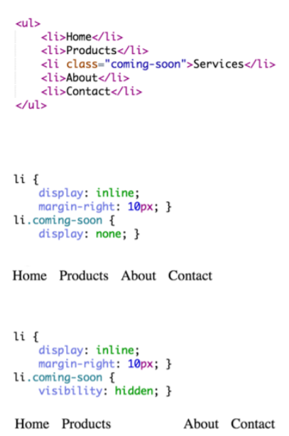
Visibility and layout
Can force elements to be inline or block element.
display: inline
display: block
Can cause element to not be laid out or take up any space
display: none
Very useful for content that is dynamically added and removed.
Can cause boxes to be invisible, but
still take up space
visibility: hidden;

Slide 26
Font properties
Property | Description
font | Sets all the font properties in one declaration
font-family | Specifies the font family for text
font-size | Specifies the font size of text
font-style | Specifies the font style for text
font-variant | Specifies if a text should be displayed in a small-caps font
font-weight | Specifies the weight of the font

Slide 27
Font CSS example
p, div {
font-family: “Times New Roman”, Arial, Serif;
font-style: italic;
font-size: 12px;
}

Slide 28
List properties
Property | Description
list-style | Sets all the properties for a list in one declaration
list-style-image | Specifies an image as the list-item marker
list-style-position | Specifies where to place the list-item marker
list-style-type | Specifies the type of list-item marker

Slide 29
List CSS example
ul {
list-style-type: circle;
list-style-position: inside;
}

Slide 30
Table properties
Property | Description
border-collapse | Specifies whether or not table borders should be collapsed
border-spacing | Specifies the distance between the borders of adjacent cells
caption-side | Specifies the placement of a table caption
empty-cells | Specifies whether or not to display borders and background on empty cells in a table
table-layout | Sets the layout algorithm to be used for a table

Slide 31
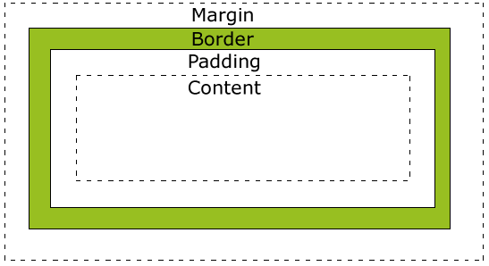
The CSS box model
Each HTML element is a “box” from CSS perspective; it has a margin, border, padding and content

Slide 32
The CSS Box model (2)
Margin: clears an area around the border; does not have a background color, is completely transparent
Border: lies around content and padding; has the background color of the box
Padding: clears an area around the content; has the background color of the box
Content: the actual content (text) of the box
The height and width attributes do not specify the total height and width of the HTML element; they are calculated by:
Total width=width+left padding+right padding+left border+
right border+left margin+right margin
Total height=height+top padding+bottom padding+top border+ bottom border+top margin+bottom margin

Slide 33
Dimension properties
Property | Description
height | Sets the height of an element
max-height | Sets the maximum height of an element
max-width | Sets the maximum width of an element
min-height | Sets the minimum height of an element
min-width | Sets the minimum width of an element
width | Sets the width of an element

Slide 34
Margin and padding properties
Property | Description
margin | Sets all the margin properties in one declaration
margin-bottom | Sets the bottom margin of an element
margin-left | Sets the left margin of an element
margin-right | Sets the right margin of an element
margin-top | Sets the top margin of an element
padding | Sets all the padding properties in one declaration
padding-bottom | Sets the bottom padding of an element
padding-left | Sets the left padding of an element
padding-right | Sets the right padding of an element
padding-top | Sets the top padding of an element

Slide 35
Margin CSS example
div {
margin-top: 100px;
margin-bottom: 100px;
margin-left: 5%;
margin-right: 5%;
}

Slide 36
Border and outline properties
Property | Description
border | Sets all the border properties in one declaration
border-bottom | Sets all the bottom border properties in one declaration
border-bottom-color | Sets the color of the bottom border
border-bottom-style | Sets the style of the bottom border
border-bottom-width | Sets the width of the bottom border
border-color | Sets the color of the four borders
border-left | Sets all the left border properties in one declaration
border-left-color | Sets the color of the left border
border-left-style | Sets the style of the left border
border-left-width | Sets the width of the left border
border-right | Sets all the right border properties in one declaration
border-right-color | Sets the color of the right border
border-right-style | Sets the style of the right border
border-right-width | Sets the width of the right border
border-style | Sets the style of the four borders
border-top | Sets all the top border properties in one declaration
border-top-color | Sets the color of the top border
border-top-style | Sets the style of the top border
border-top-width | Sets the width of the top border
border-width | Sets the width of the four borders
outline | Sets all the outline properties in one declaration
outline-color | Sets the color of an outline
outline-style | Sets the style of an outline
outline-width | Sets the width of an outline

Slide 37
Border CSS example
div {
border-top-style: solid;
border-bottom-style: solid;
border-left-style: dotted;
border-right-style: dotted;
border-width: 2px;
border-color: #00ff00;
}

Slide 38
Positioning
static positioning: the default mode; a static element is positioned according to the normal flow of the page;
fixed positioning: element will not move even if the window is scrolled (position: fixed; top: 20px; right: 40px); elements are removed from the normal flow and can overlap other elements
relative positioning: element is positioned relative to its normal position; element can be moved and overlap other elements , but the reserved space form the element is preserved in the normal flow (position: relative)
absolute positioning: element is positioned relative to the first parent element that has a position other then static (if none, <html>); elements are removed from the normal flow and can overlap other elements; (position: absolute)
z-index property defines the stack order of an element

Slide 39
Floating
With floating, an html element can be pushed left or right allowing other elements to wrap around it
HTML elements can float horizontally left or right (not vertically)
Configured using the float: left | right | none | inherit display property

Slide 40
Positioning properties
Property | Description
bottom | Sets the bottom margin edge for a positioned box
clear | Specifies which sides of an element where other floating elements are not allowed
clip | Clips an absolutely positioned element
cursor | Specifies the type of cursor to be displayed
display | Specifies the type of box an element should generate
float | Specifies whether or not a box should float
left | Sets the left margin edge for a positioned box
overflow | Specifies what happens if content overflows an element's box
position | Specifies the type of positioning for an element
right | Sets the right margin edge for a positioned box
top | Sets the top margin edge for a positioned box
visibility | Specifies whether or not an element is visible
z-index | Sets the stack order of an element

Slide 41
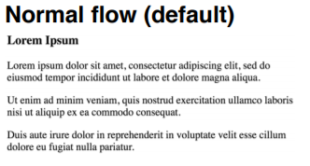
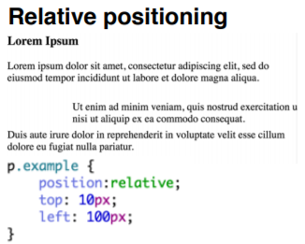
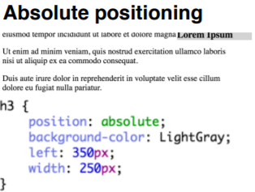
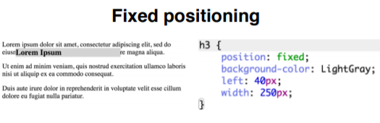
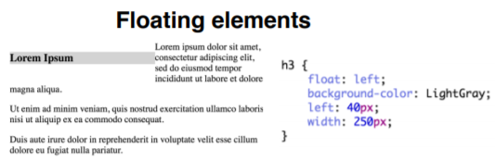
Positioning Examples

Slide 42
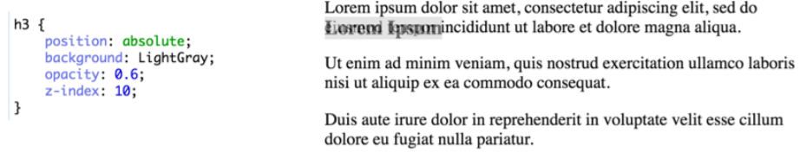
Stacking elements
Elements taken out of normal flow may be stacked on top of each other
Can set order with z-index property
Higher numbers appear in front
Can set opacity of element, making occluded elements partially visible

Slide 43
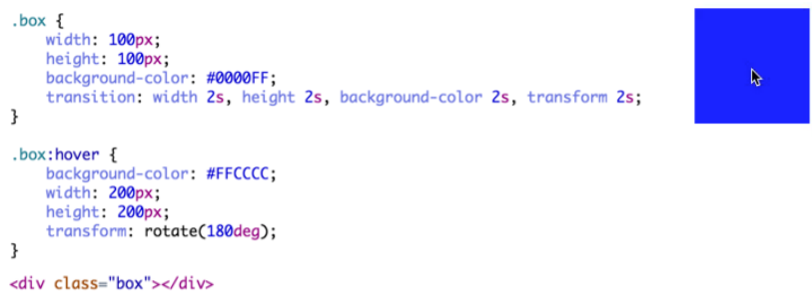
Transitions
transition: [property time], …, [property time]
When new class is applied, specifies the time it will take for each property to change
Can use all to select all changed properties

Slide 44
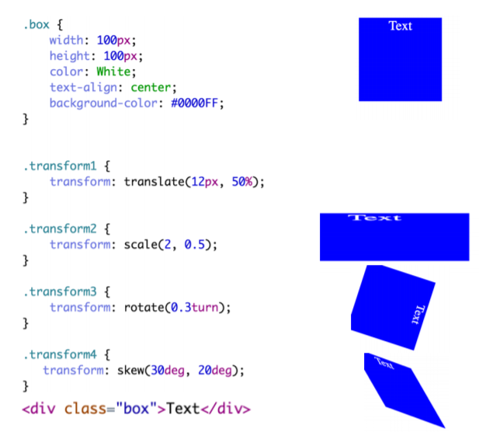
Transform - examples

Slide 45
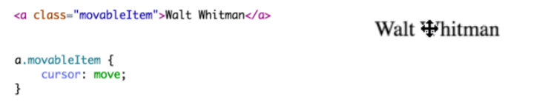
Cursor
Can change the default cursor with cursor attribute
auto, crosshair, pointer, move, text, wait, help, url(“cursor.gif”)
Should only do this if action being taken clearly matches cursor type

Slide 46
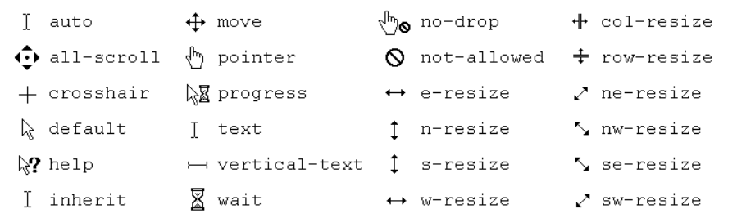
CSS Cursors

Slide 47
CSS level 3

Slide 48
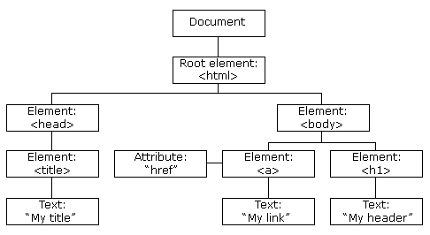
DOM Tree

Slide 49
CSS Selectors (1)
E[attr^=“str”] - an E element whose “attr” attribute begins with “str”
E.g., a[href^='http://sales.']{color: teal;}
E[attr$=“str”] - an E element whose “attr” attribute ends with “str”
E.g., a[href$='.jsp']{color: purple;}
E[attr*=“str”] - an E element whose “attr” attribute contains substring “str”
E.g., img[src*='artwork’]{
border-color: #C3B087 #FFF #FFF #C3B087;
}

Slide 50
CSS Selectors (2)
E:nth-child(n) - an E element, the n-th child of its parent
E:nth-last-child(n) - an E element, the n-th child of its parent, counting from the last one
E:nth-of-type(n) - an E element, the n-th sibling of its type
E:nth-last-of-type(n) - an E element, the n-th sibling of its type, counting from the last one
E:first-child - an E element, first child of its parent (in CSS2.1)
E:last-child - an E element, last child of its parent

Slide 51
CSS Selectors (3)
E:first-of-type - an E element, first sibling of its type
E:last-of-type - an E element, last sibling of its type
E:only-child - an E element, only child of its parent
E:only-of-type - an E element, only sibling of its type
E:empty - an E element that has no children
E:not(s) - an E element that does not match simple selector s
E > F - an F element child of an E element (in CSS2.1)
E + F - an F element immediately preceded by an E element (in CSS2.1)
E ~ F - an F element preceded by an E element

Slide 52
Responsive web design
Document should look good on any device (desktop, tablet, phone)
Use CSS to shrink, enlarge, hide or move html content in order to look good on any screen
Setting viewport:
<meta name="viewport" content="width=device-width, initial-scale=1.0">
- sets the width of the page to follow the screen width of the device
- sets the initial zoom level to 1 (no zoom)
Do not rely on a particular viewpoint
Use relative (percentage, %) dimensions: width, height
Use media-queries to apply different styles to large/small screens

Slide 53
Responsive web design (2)
Use @media to apply css style only if a condition is met
@media only screen and (max-width: 500px) { #div1 { width: 100%; } }
@media only screen and (min-width: 500px) { ….
}
@media only screen and (orientation: landscape) { …
}

Slide 54
CSS neat typography: web fonts
See Google web fonts: https://fonts.google.com/
Usage example:
<link rel="stylesheet" type="text/css"
href="https://fonts.googleapis.com/css?family=Jura">
<style>
body {
color: #cfd2da;
font-family: 'Jura', sans-serif;
font-size: 0.9rem;
}
</style>

Slide 55

Neat CSS icons: google icons
<link rel="stylesheet" href="https://fonts.googleapis.com/icon?family=Material+Icons">
<i class="material-icons" style="font-size:48px;color:red“>folder</i>
<i class="material-icons" style="font-size:48px;color:red“> cloud_upload</i>

Slide 56

Neat CSS icons: fontawesome
<link rel="stylesheet" href="https://cdnjs.cloudflare.com/ajax/libs/font-awesome/4.7.0/css/font-awesome.min.css">
<i class="fa fa-car" style="font-size:60px;color:red;"></i>

Slide 57
Thank you!

